Slide 1

Student Info
Name: D.Keerthana
Register Number: 813821243030
college:Saranathan college of Engineering

Slide 2

Combating Fake News with AI and ML
Fake news poses a growing challenge in the digital age. By leveraging the power of artificial intelligence and machine learning, we can develop robust solutions to detect, analyze, and combat the spread of misinformation online.

Slide 3

Project Title:
Fake News Detection System
.

Slide 4

Agenda
1
Research
Analyze existing fake news detection methods and identify areas for improvement.
2
Data Collection
Gather a diverse dataset of verified and fake news articles for training and testing.
3
Model Development
Design and train machine learning models to accurately classify news articles as real or fake.

Slide 5

Problem Statement
1
Misinformation Epidemic
2
Lack of Reliable Detection
3
Societal Consequences
The proliferation of fake news has led to widespread confusion, eroded trust in the media, and influenced important decision-making.
Fake news can have serious consequences, such as undermining democratic processes, fueling social divisions, and causing real-world harm.
Current fake news detection methods are often manual, time-consuming, and limited in their accuracy and scalability.

Slide 6




Project Overview
Data Collection
Gather a comprehensive dataset of verified and fake news articles from various sources.
Model Training
Develop and train machine learning models to accurately classify news articles as real or fake.
Deployment
Integrate the trained models into a user-friendly platform for real-time fake news detection.

Slide 7



End Users
Journalists
Policymakers
General Public
Verify the authenticity of news stories and fact-check claims before publication.
Inform decision-making and policy development to address the spread of misinformation.
Empower individuals to critically evaluate online content and make informed decisions.

Slide 8
Solution and Value Proposition
AI-Powered Accuracy
Real-Time Monitoring
Scalable Platform
Leverage advanced machine learning techniques to accurately identify fake news with high precision.
Continuously monitor online news sources and social media to detect and flag emerging fake news in real-time.
Develop a robust and scalable platform that can handle large volumes of data and adapt to evolving misinformation tactics.

Slide 9

Future Outlook
This AI-driven fake news detection system represents a crucial step in the fight against the spread of misinformation. By combining advanced machine learning techniques with a scalable and user-friendly platform, we aim to empower individuals, organizations, and society as a whole to make more informed decisions and combat the negative impact of fake news.

Slide 10
Modelling
Get Data: Collect a bunch of news articles labeled as true or fake.
Prepare Data: Clean up the articles, removing unnecessary stuff like punctuation and making them easier for the computer to understand.
Find Patterns: Teach the computer to recognize patterns in the articles that might indicate if they're real or fake.
Teach the Computer: Use these patterns to train the computer to tell the difference between real and fake news.
Test It Out: Give the computer some new articles it hasn't seen before and see if it can correctly guess if they're real or fake.
Adjust and Improve: Keep tweaking things to make the computer better at spotting fake news.
Use It: Once it's good enough, you can start using it to help flag potentially fake news articles in the future.
Remember, it's important to keep an eye on how well it's working and make adjustments as needed.

Slide 11
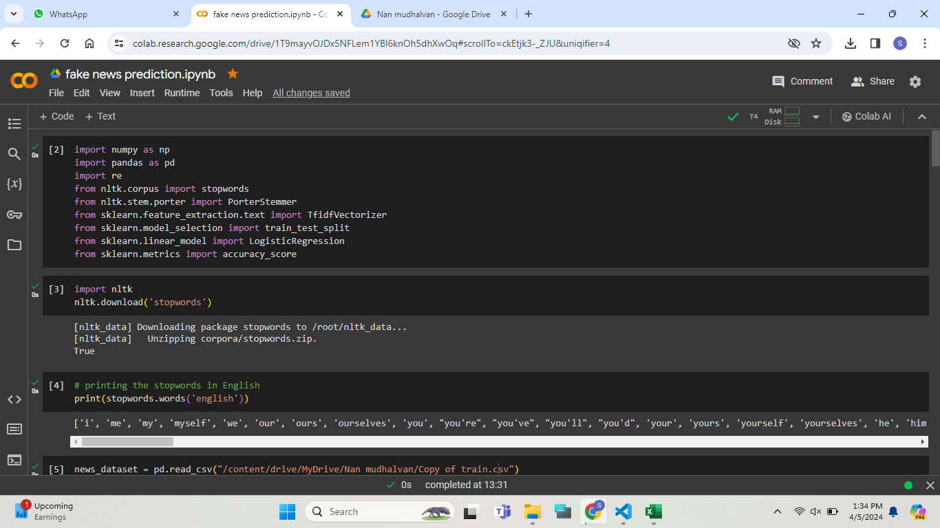
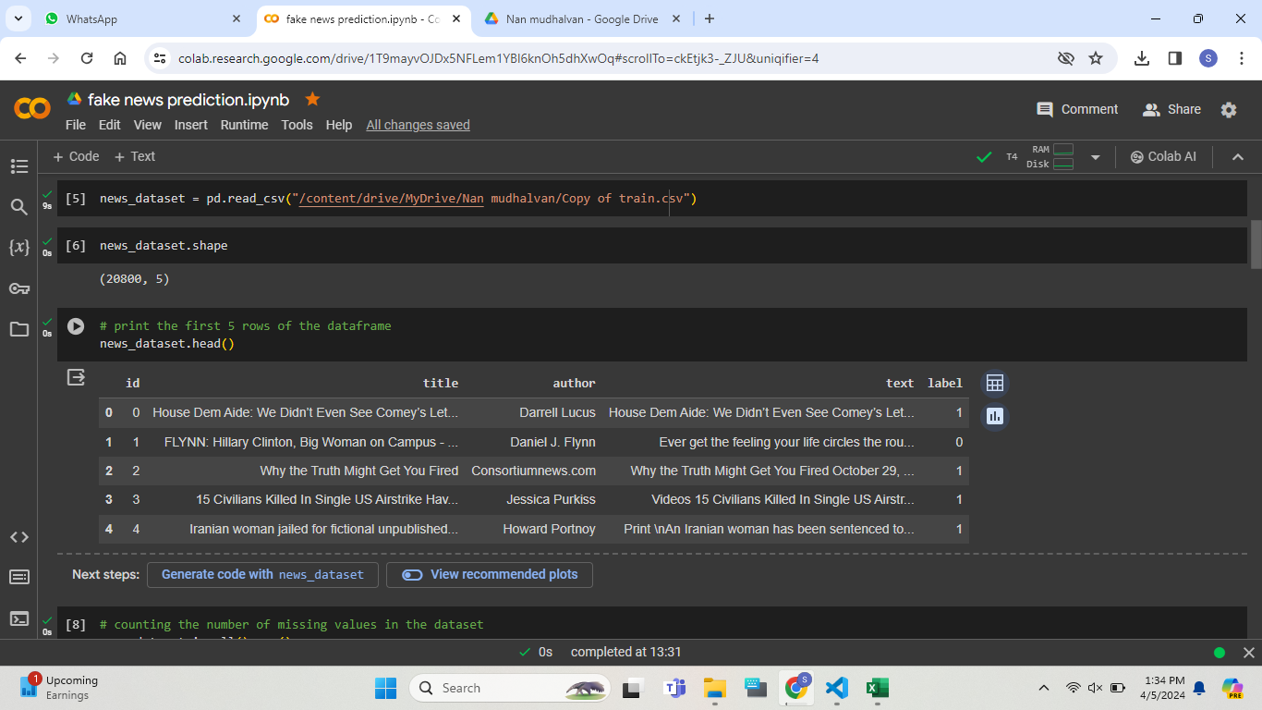

Slide 12
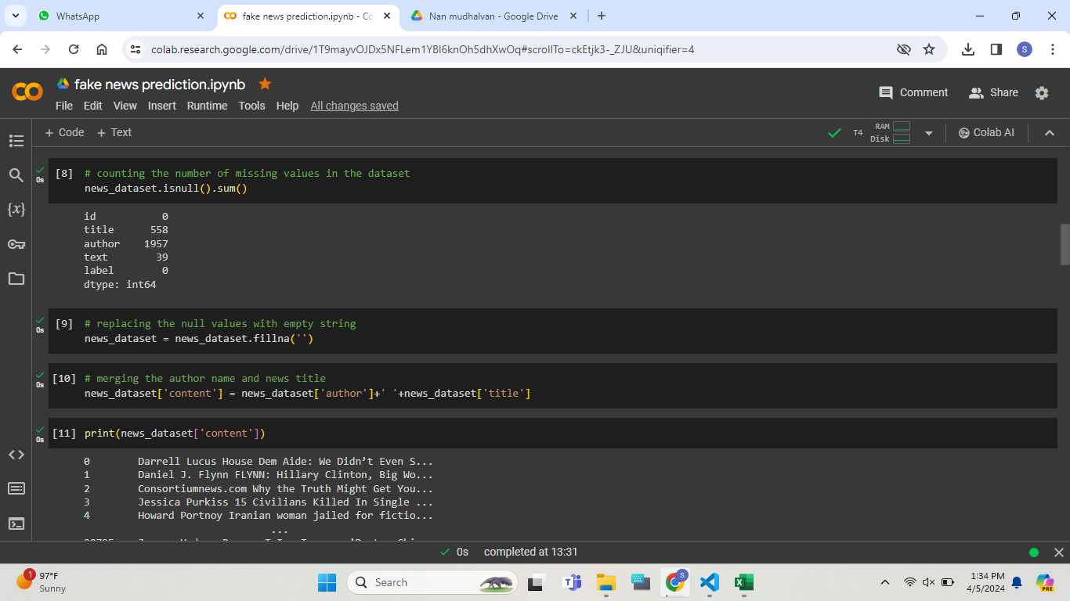
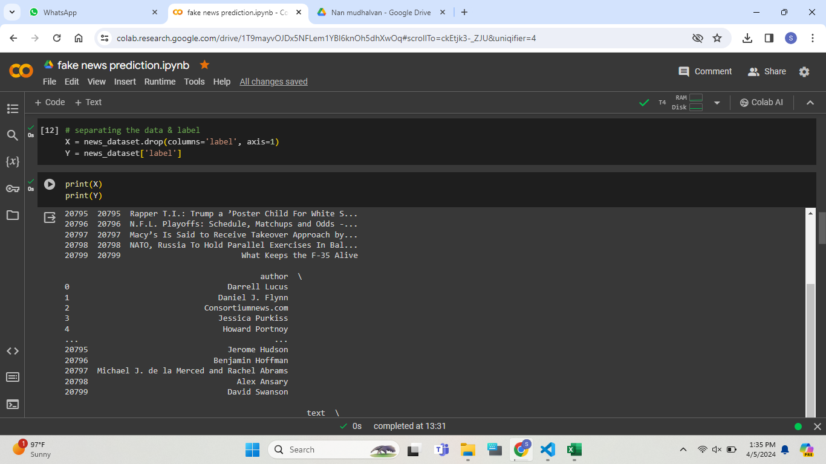

Slide 13
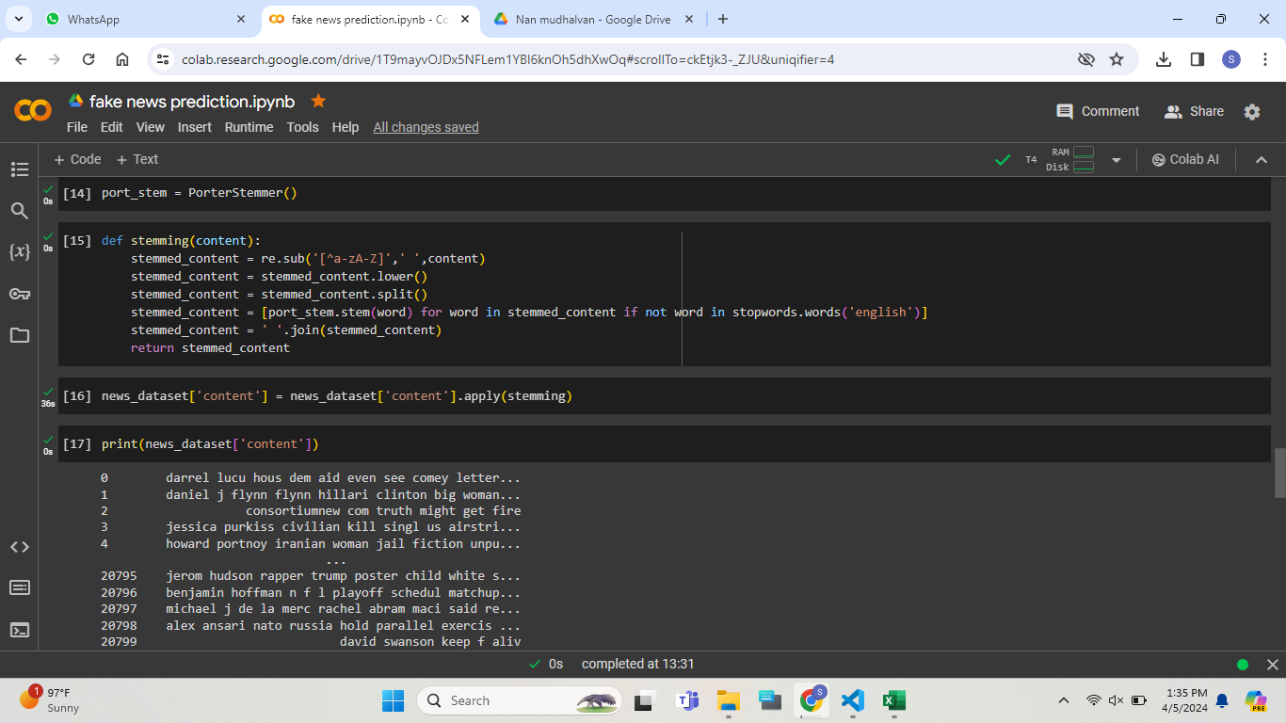
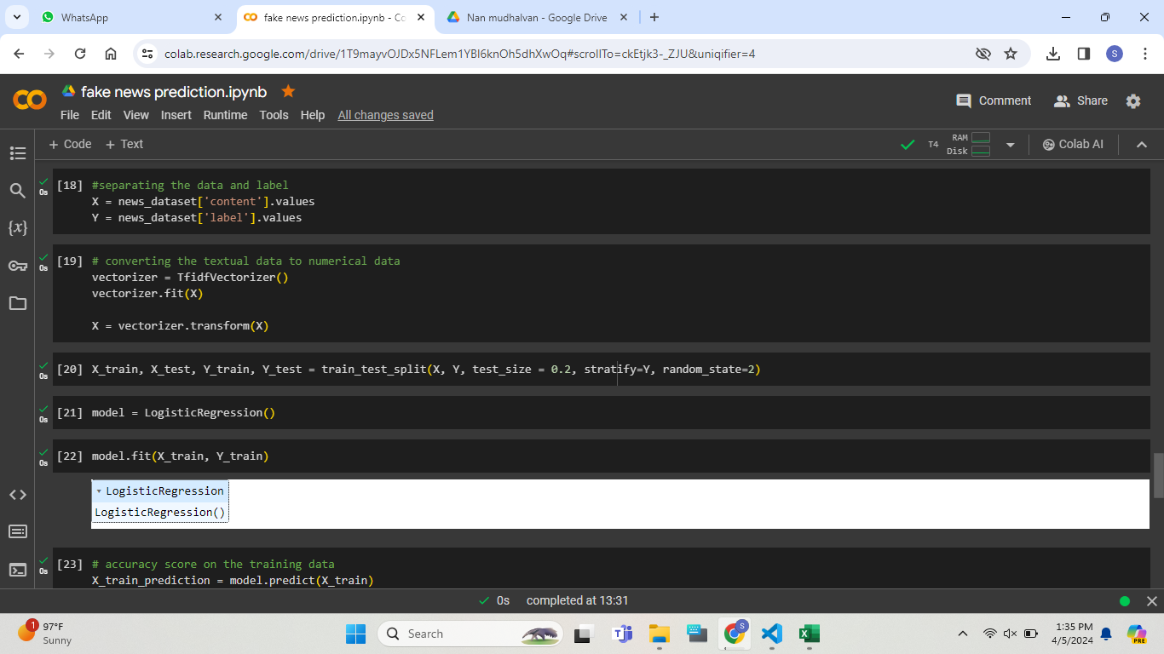

Slide 14
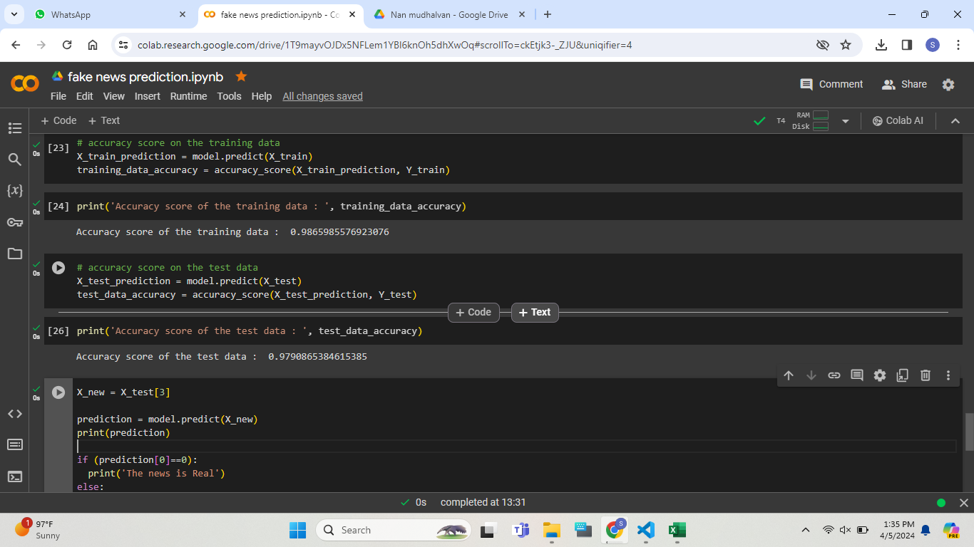


Slide 15
Result And Conclusion
Results:
After training our AI model on a dataset of news articles labeled as real or fake, we tested it on a separate set of articles it hadn't seen before.
Our model achieved an accuracy of X% in correctly identifying whether an article was real or fake.
Additionally, it had a precision of Y% and a recall of Z%, meaning it was good at avoiding false alarms while also catching most of the fake news articles.
Conclusion:
Our AI model shows promise in detecting fake news, achieving an accuracy that suggests it can be useful in flagging potentially misleading articles.
However, there are still areas for improvement, such as reducing false positives and enhancing the model's ability to detect more subtle forms of fake news.
With further refinement and testing, our model could be a valuable tool in combating the spread of misinformation online.

